Slide 1
Intro to GIS with Python Workshop
Presented by:
Michael Remington

Slide 2
Table of Contents
What is GIS?
Spatial Data Types
Coordinate Systems and Map Projections
Data Sources
Data Management
Spatial Analysis

Slide 3
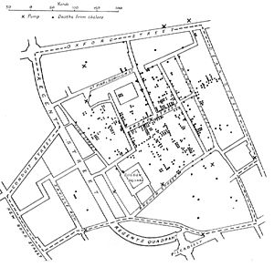
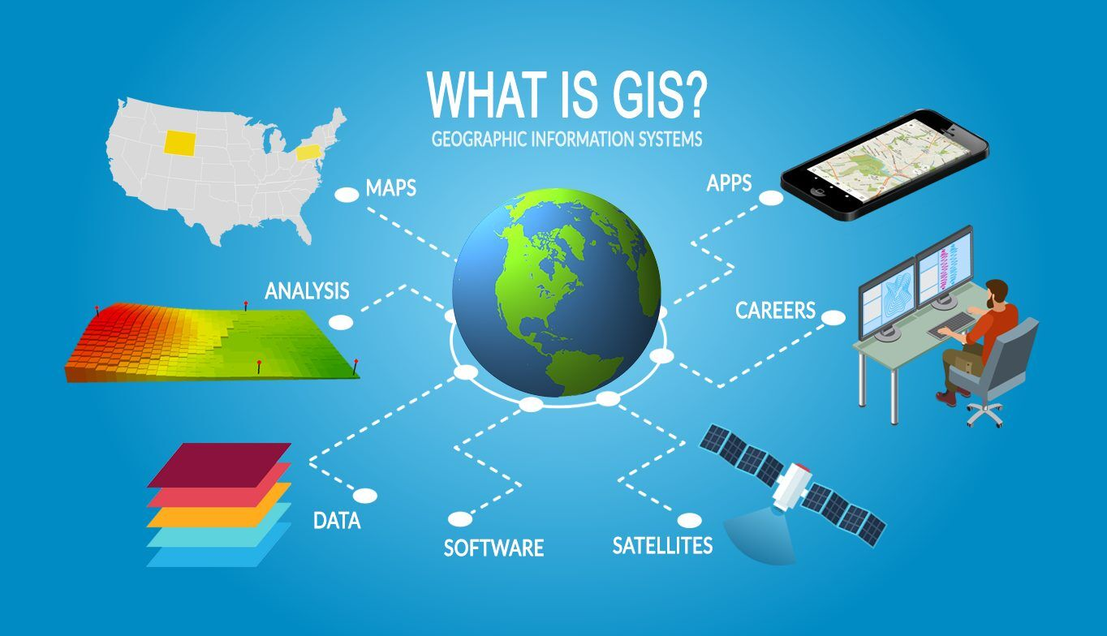
What is GIS?
GIS: Geographic Information Systems

Slide 4





Popular GIS programs

Slide 5
2) Spatial Data Types
Raster
Vector
A grid like overlay where each cell represents an area of land.
Each cell contains a value characterizing the map.
Good for representing continuous data such as elevation, temperature, precipitation, or satellite data
Points, lines, and polygons most often composed of coordinates.
Often has attributes associated as well.
Good for representing discrete data such as roads, rivers, and points of interest.

Slide 6
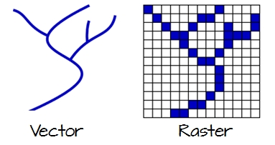

Slide 7
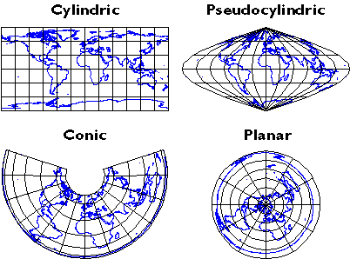
3) Coordinate Systems and Map Projections
Coordinate Systems:
Geographic Coordinate System (GCS) 3D
Projected Coordinate System (PCS) 2D
Map Projections:

Slide 8
4) Data Sources: Free data sets
NOAA: National Oceanagraphic and Atmospheric Association
https://www.weather.gov/gis/NWS_Shapefile
Census Bureau
https://www.census.gov/geographies/mapping-files/
Natural Earth
https://www.naturalearthdata.com/
OpenStreetMap
https://www.openstreetmap.org/
ArcGIS website
https://www.arcgis.com/
Global Data Lab
https://globaldatalab.org/gdi/

Slide 9
4) Data Soure: Python APIs
ArcGIS API for Python
QGIS Python API
GeoPandas datasets
Google Maps Python API
OpenStreetMap Python API (osmnx)

Slide 10
5) Data Management: File Tpes
Vector Data:
Shapefile (.shp)
GeoJSON (.geojson)
File Geodatabase (.gdb)
Excel, CSV
Raster Data
GeoTIFF (.tif)
ERDAS Imagine (.img)
ASCII Grid
Esri GRID

Slide 11
6) Spatial Analysis: Popular Techniques
Buffering
Overlay Analysis
Spatial Joins
Spatial Interpolation
Spatial Statistics
Geocoding and Geolocation

Slide 12
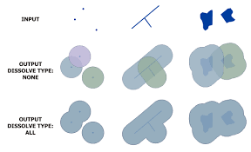
Buffering Analysis
Creates a zone of specified distance around features such as points, lines, or polygons.
Useful for proximity analysis, determining spatial relationships, and identifying areas within a certain distance of a feature

Slide 13
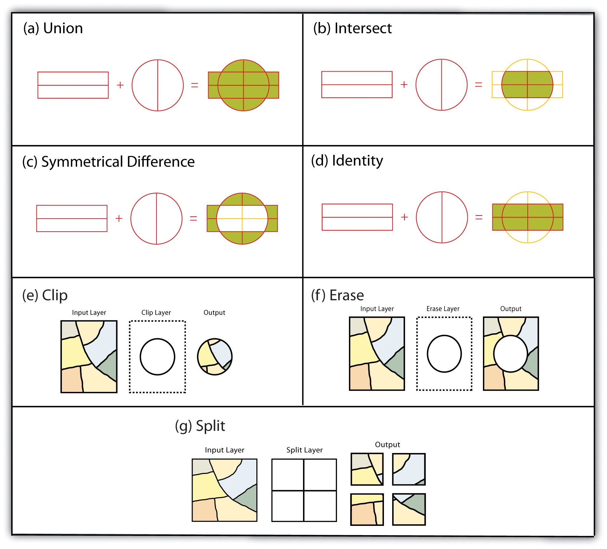
Overlay Analysis
Combines multiple layers to create new output layers based on spatial relationships.
Overlay operations include intersection, union, difference, and identity. They help identify areas of overlap or proximity, perform spatial queries, and generate new datasets.

Slide 14
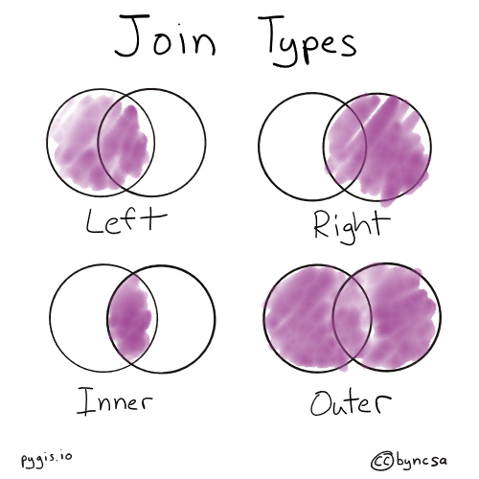
Spatial Joins
Combines attribute data from one layer to another based on their spatial relationship.
It allows you to transfer attributes from one layer to another based on shared spatial characteristics, such as joining population data to administrative boundaries.

Slide 15
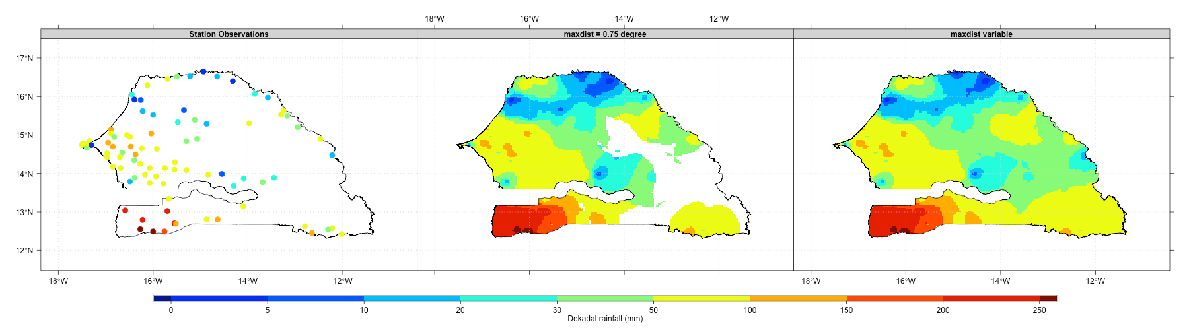
Spatial Interpolation
Estimates values for locations where data is not available based on nearby sample points.
methods: include inverse distance weighting, kriging, and spline interpolation.
Commonly used in environmental modeling, creating continuous surfaces, and predicting values in unmeasured locations.

Slide 16
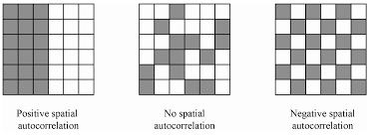
Spatial Statistics
Analyzes spatial patterns and relationships within datasets.
Spatial statistical techniques include clustering analysis, spatial autocorrelation, hotspot analysis, and spatial regression.
They help identify spatial trends, patterns, and relationships between variables.

Slide 17
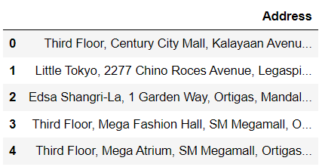
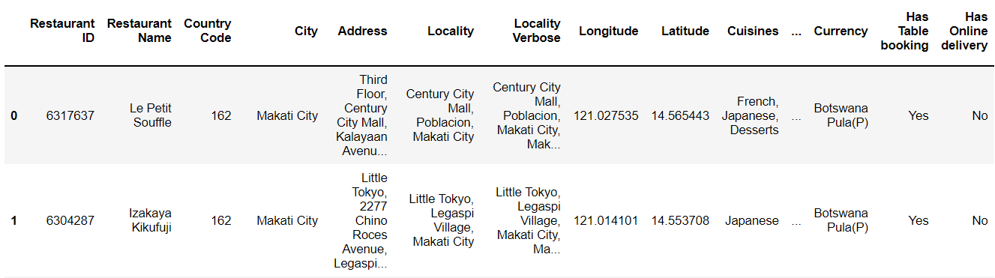
Geocoding and geolocation

